Slide 1


ATLIQ HARDWARE
Consumer Goods
Ad_Hoc Insights
Presented by: Kori Ganesh

Slide 2
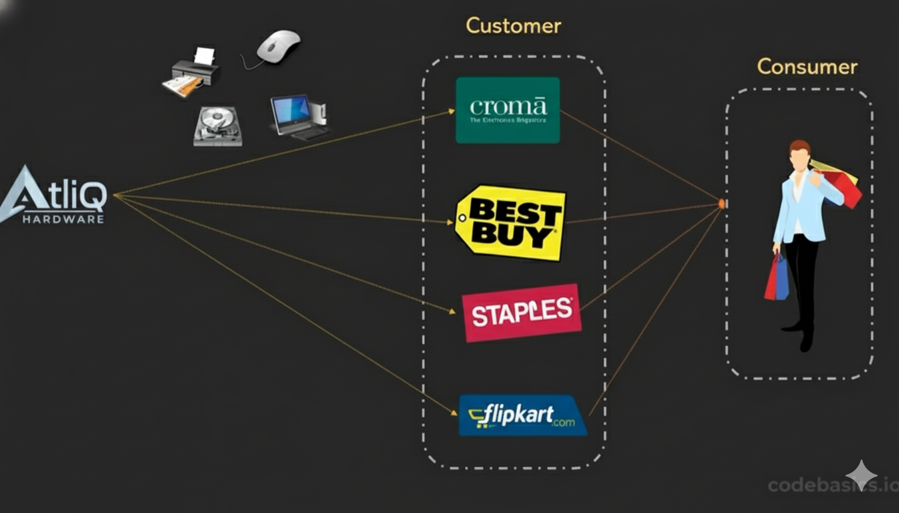
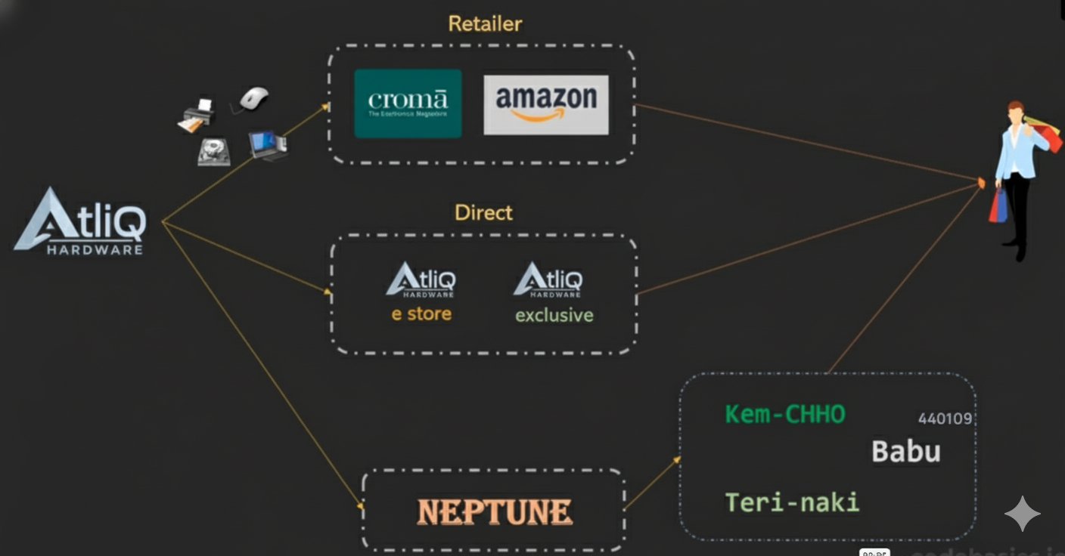
ATLIQ HARDWARE
AtliQ Hardwares utilizes a diverse multi-channel distribution strategy, reaching its customers through three primary sales channels: Retailers, Direct-to-Consumer (Direct), and Distributors.
AtliQ Hardwares (imaginary company) is one of the leading computer hardware producers in India and has expanded well in other countries too.

Slide 3
ATLIQ HARDWARE
Problem statement
Task given
The management lacks real-time insights for quick and data-informed decisions, leading to missed growth opportunities.
Tony Sharma, their data analytics director, he decided to conduct a SQL challenge, which will help him to hire junior data analyst who understand both tech and soft skills.
Action taken
Insights
I performed SQL queries
to analyze sales, products, and regional performance.
I gave data-driven recommendations for faster decision-making.

Slide 4
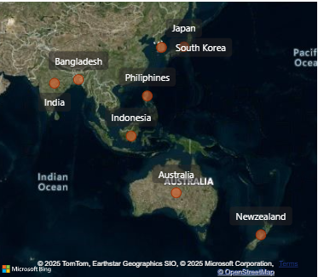
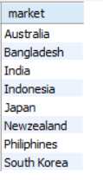
ATLIQ HARDWARE
1. Provide the list of markets in which customer "Atliq Exclusive" operates its business in the APAC region.
Output:

Slide 5
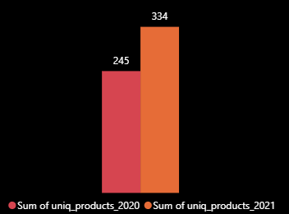
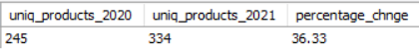
ATLIQ HARDWARE
2. What is the percentage of unique product increase in 2021 vs. 2020? The final output contains these fields,
unique_products_2020
unique_products_2021
percentage_chg
36.33%
Output:

Slide 6
ATLIQ HARDWARE
Insights:
The 36.33% increase in unique products (334 to 245).
It's a great strategy to expand market share.
It is important to check whether the products are generating revenue and the gross margin so that it will not make loss.
The 36.33% product expansion in 2021 was a significant success, generating approximately 475 Million in Gross Margin for AtliQ Hardwares.

Slide 7
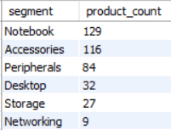
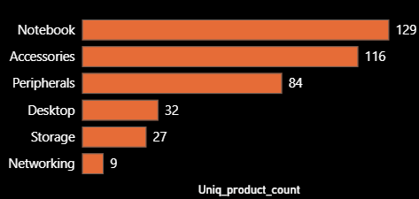
ATLIQ HARDWARE
3. Provide a report with all the unique product counts for each segment and sort them in descending order of product counts. The final output contains 2 fields,
1. segment,
2. product_count
Output:

Slide 8
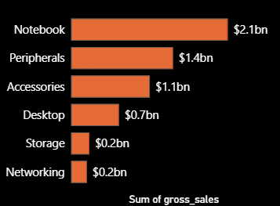
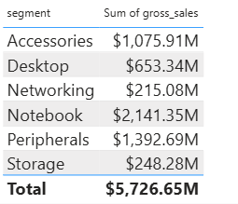
ATLIQ HARDWARE
Insights:
The top 3 segments (Notebook, Peripherals, Accessories) make up 83% of SKUs, but contribution to revenue is uneven.
2. Accessories have 116 SKUs but generate only $1.07B, while Peripherals with 84 SKUs generate $1.39B. This indicates low-efficiency SKUs that require review.

Slide 9
ATLIQ HARDWARE
3. Networking, despite having only 9 SKUs, generates $215M — highest per-product efficiency in the entire portfolio.
Similarly, Desktop outperforms Storage with minimal SKU difference generating 3X revenue compare to storage
4. Notebook accounts for 37% of total gross sales.
This level of concentration increases business risk and requires diversification or market hedging.

Slide 10
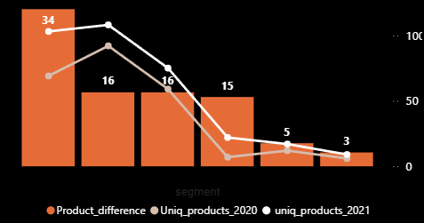
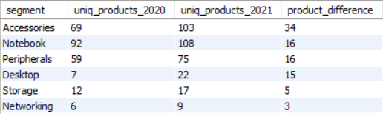
ATLIQ HARDWARE
4. Follow-up: Which segment had the most increase in unique products in 2021 vs 2020? The final output contains these fields,
Segment, product_count_2020, product_count_2021, product_difference
Output:

Slide 11
ATLIQ HARDWARE
Insights:
Accessories grew from 69 → 103 products = +34 SKUs But earlier data shows Accessories revenue is lower than Peripherals, even though Peripherals grew only +16 SKUs.
The Accessories expansion in 2021 looks inefficient. You’re adding more products than any other segment but not seeing matching financial returns.
Implication: This suggests poor product strategy, weak demand forecasting, or low product differentiation.

Slide 12
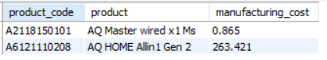
ATLIQ HARDWARE
5. Get the products that have the highest and lowest manufacturing costs. The final output should contain these fields,
Product code
product
Manufacturing cost
Output:

Slide 13
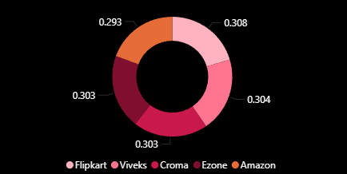
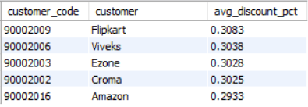
ATLIQ HARDWARE
6. Generate a report which contains the top 5 customers who received an average high pre_invoice_discount_pct for the fiscal year 2021 and in the Indian market. The final output contains these fields,
Customer code
Customer
average discount percentage
Output:

Slide 14
ATLIQ HARDWARE
Insights:
The average pre-invoice discount across major customers (Amazon, Flipkart, Croma, Viveks, Ezone) remains tightly clustered between 29–31%, indicating AtliQ’s discounting strategy is uniformly applied rather than performance-based.
Since these customers drive the majority of revenue, applying a uniform discount structure creates pricing inefficiency and increases financial risk.

Slide 15
ATLIQ HARDWARE
7. Get the complete report of the Gross sales amount for the customer “Atliq Exclusive” for each month . This analysis helps to get an idea of low and high-performing months and take strategic decisions. The final report contains these columns:
1. Month
2. Year
3. Gross sales Amount

Slide 16
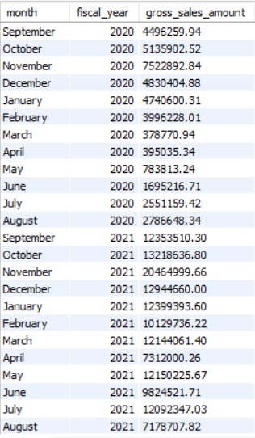
ATLIQ HARDWARE
High Sales (November)
FY 2020
Low Sales (Jun – Aug)
High Sales (November)
FY 2021

Slide 17
ATLIQ HARDWARE
Insights:
1. Gross sales in FY 2021 increased significantly across all months compared to FY 2020, indicating successful business expansion.
2. November 2021 recorded the highest sales, likely supported by festive demand such as Diwali, but the overall uplift is consistent throughout the year rather than driven by a single event.
3. Jun–Aug is a recurring weak window, but FY 2021 performance shows it is partially controllable through better execution

Slide 18
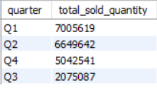
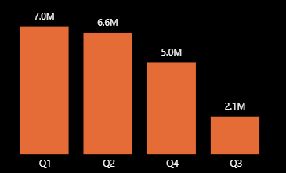
ATLIQ HARDWARE
8. In which quarter of 2020, got the maximum total sold quantity? The final output contains these fields sorted by the total sold quantity,
1. Quarter
2. Total sold quantity
Output:

Slide 19
ATLIQ HARDWARE
Insights:
With the fiscal year starting in September, Q1 (Sep–Nov) and Q2 (Dec–Feb) show strong sales due to major festival and holiday-driven demand.
However, Q3 (Mar–May) shows an abnormally sharp decline in sold quantity (nearly 70%), which is far beyond normal seasonality and indicates a potential operational or supply chain disruption during this period.
Q4 (Jun–Aug) shows partial recovery, suggesting the issue was temporary.
This Q3 drop needs to be investigated with production, supply chain, and sales operations to identify the exact cause.”

Slide 20
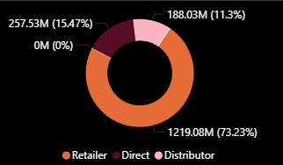
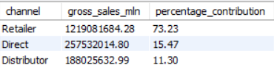
ATLIQ HARDWARE
9. Which channel helped to bring more gross sales in the fiscal year 2021 and the percentage of contribution? The final output contains these fields,
Channel
Gross sales mln
percentage contribution
Output:

Slide 21
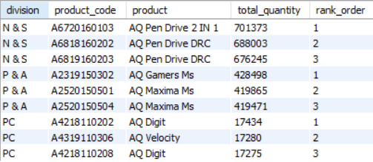
ATLIQ HARDWARE
10. Get the Top 3 products in each division that have a high total_sold_quantity in the fiscal year 2021? The final output contains these fields,
1. Division, 2. Product_code, 3. Product, 4. Total sold quantity, 5. Rank order
Output:

Slide 22
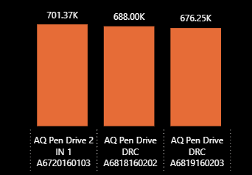
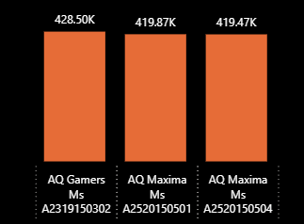
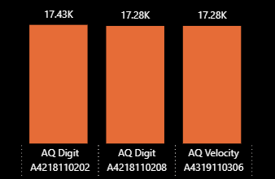
ATLIQ HARDWARE
Division: N & S
Division: P & A
Division: PC

Slide 23
ATLIQ HARDWARE
Thank you

